Slide 1
Chatbot Project Bot created using NLTK and Keras in Python
LEBANESE UNIVERSITY
FACULTY OF ENGINEERING-BRANCH III
Presented to:
Dr. Mohammad Awde
Presented by:
Fatima Kassir 5587
Ali Al Hakim 5470

Slide 2
01
02
What is CHATBOT
APPLICATION
&BENEFITS
& PROCESS
03
04
DATASET
MODEL: RNN
& LSTM
05
TRAINING
code
06
EXECUTING
code

Slide 3
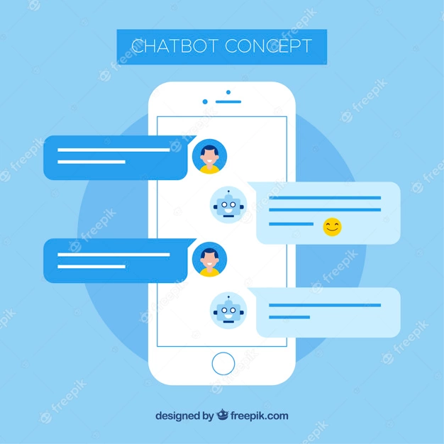

What is Chatbot?
A chatbot is an intelligent piece of software that is capable of communicating and performing actions similar to a human.

Slide 4
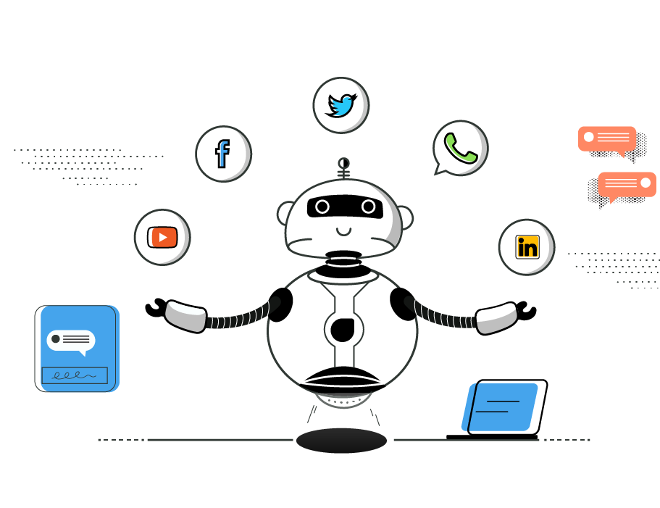
What is
Chatbots?
Chatbots leverage chat mediums like SMS text, website chat windows and social messaging services across platforms like Facebook and Twitter to receive and respond to messages.
Notes:
Chatbots are programs built to automatically engage with received messages. Chatbots can be programmed to respond the same way each time, to respond differently to messages containing certain keywords and even to use machine learning to adapt their responses to fit the situation.

Slide 5
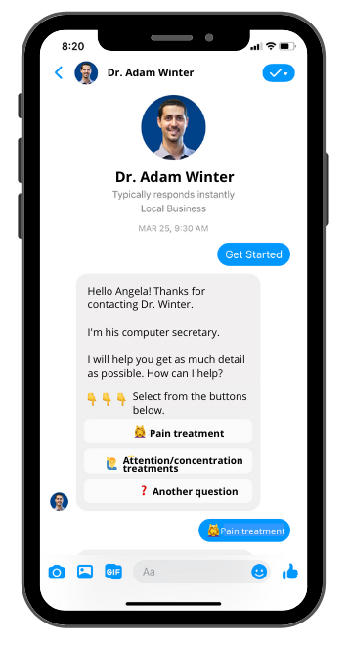
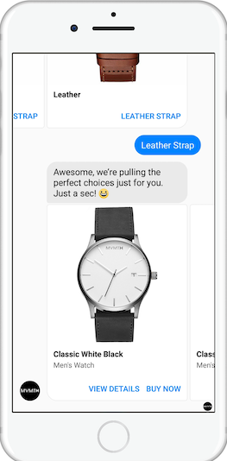
Chatbots are used a lot in: -Messaging apps -customer interaction -marketing on social network sites -instantly messaging the client. -Healthcare :to performing the role of a nurse, in the absence of one. -Company internal platforms -Politics
Application

Slide 6
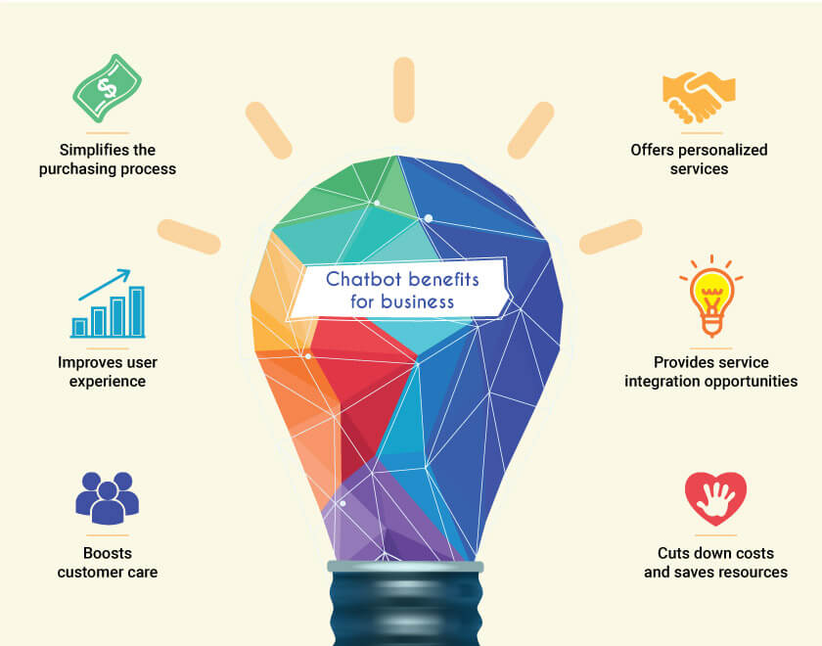
Notes:
Chatbots have a lot of benefits to make our life easier, some of them are:
It’s better for customer engagement
It simplifies the purchasing process by saving the costs
It provides service integration opportunities
It offers personalized services

Slide 7
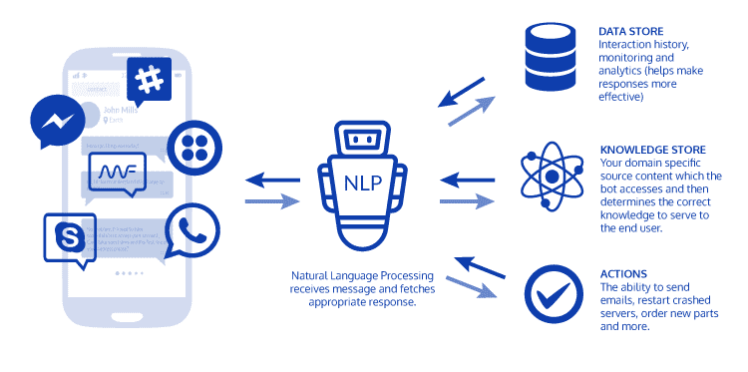
Chatbot process
Notes:
This is the basic chatbot architecture diagram that describes how the program processes a request
The main process to make chatbots work is the natural language processing
Its base work is to receive message and fetches appropriate response
The bot interacts with data store to monitor and analyze data
Also it depends on the knowledge store to determine the correct knowledge to serve to the end user
And finally the bot takes actions to send emails, messages, etc..

Slide 8
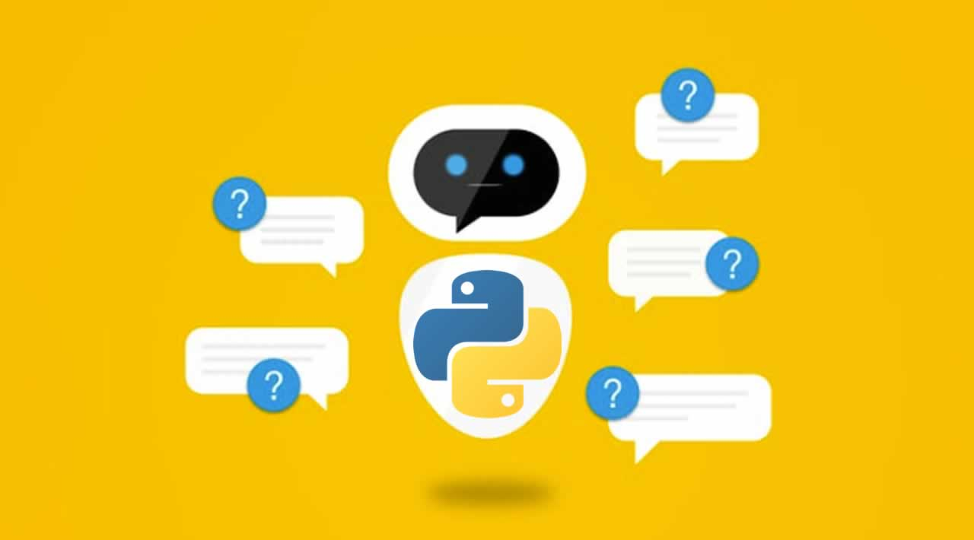
chatbot process
Here are the 5 steps to create a chatbot in Python from scratch:
Import and load the data file
Preprocess data
Create training and testing data
Build the model
Predict the response

Slide 9

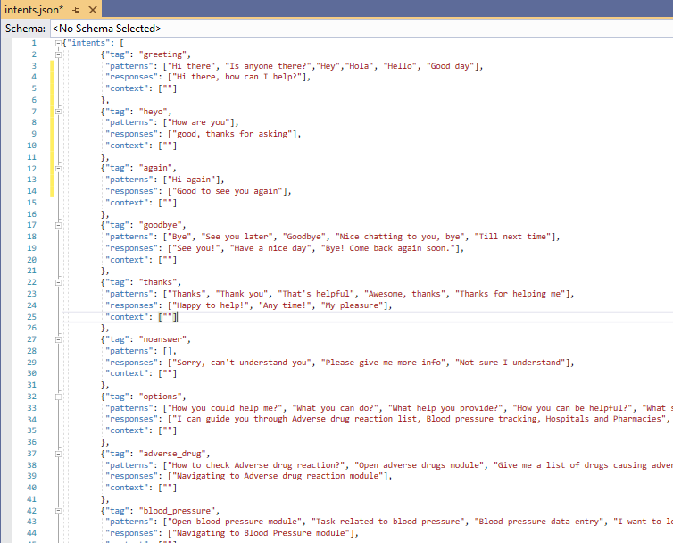

Dataset
The chatbot will be trained on the dataset which contains categories (intents), pattern and responses.
Notes:
In this Python project with source code, we are going to build a chatbot using deep learning techniques.

Slide 10
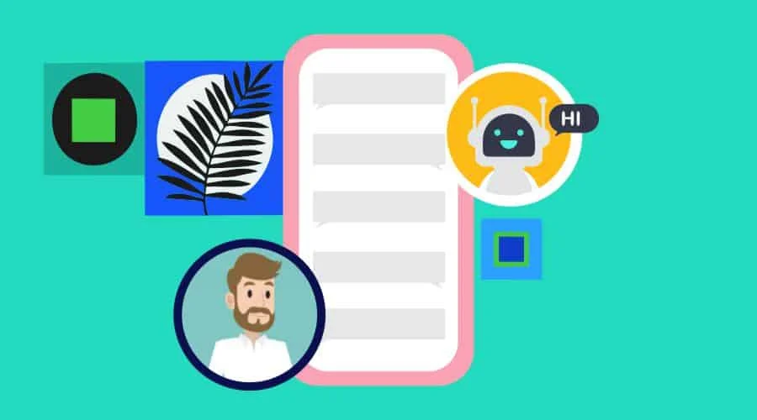
MODEL
As for the model used to train our dataset, we chose a special recurrent neural network (LSTM) to classify which category the user’s message belongs to and then we will give a random response from the list of responses.
Notes:
At end say : To understand LSTM we need to understand RNN

Slide 11
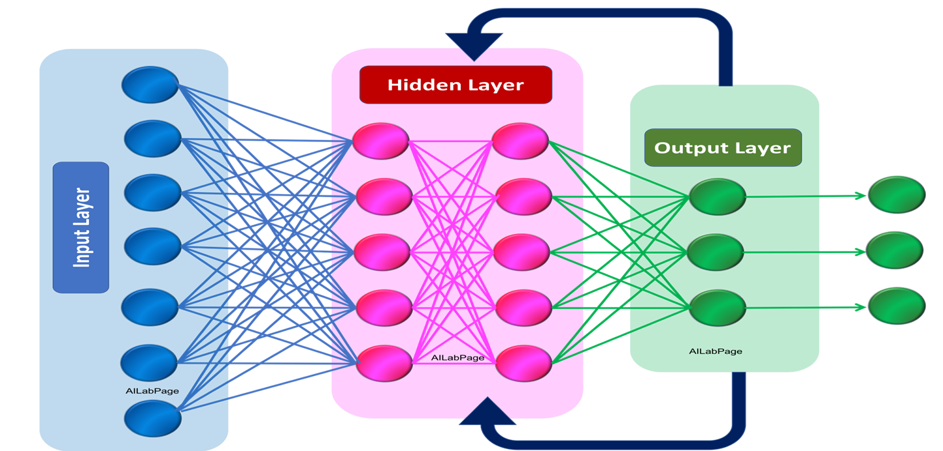
What are recurrent neural networks?
A recurrent neural network is a type of artificial neural network commonly used in speech recognition and natural language processing. Recurrent neural networks recognize data's sequential characteristics and use patterns to predict the next likely scenario.
Notes:
RNNs are used in deep learning and in the development of models that simulate neuron activity in the human brain. They are especially powerful in use cases where context is critical to predicting an outcome, and are also distinct from other types of artificial neural networks because they use feedback loops to process a sequence of data that informs the final output. These feedback loops allow information to persist. This effect often is described as memory.

Slide 12
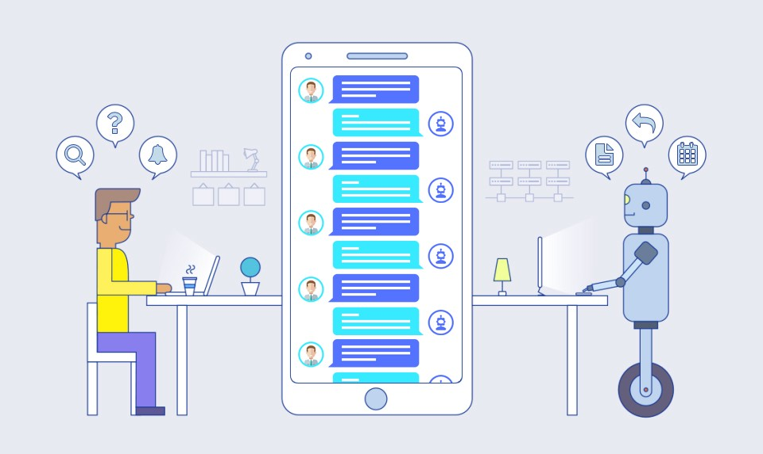
Long short-term memory units
RNNs built with LSTM units categorize data into short-term and long-term memory cells. Doing so enables RNNs to figure out which data is important and should be remembered and looped back into the network. It also enables RNNs to figure out what data can be forgotten.
Notes:
First : One drawback to standard RNNs is the vanishing gradient problem, in which the performance of the neural network suffers because it can't be trained properly. This happens with deeply layered neural networks, which are used to process complex data.
Standard RNNs that use a gradient-based learning method degrade as they grow bigger and more complex. Tuning the parameters effectively at the earliest layers becomes too time-consuming and computationally expensive.
One solution to the problem is called long short-term memory (LSTM) networks.

Slide 13

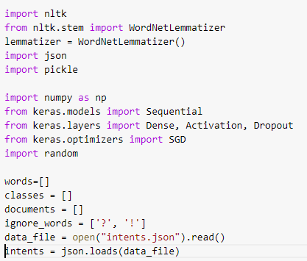
TRAINING code 1. Import and load the data file
The Natural Language Toolkit (NLTK) is a platform used for building Python programs that work with human language data for applying in statistical natural language processing (NLP).
It contains text processing libraries for tokenization, parsing, classification, stemming, tagging and semantic reasoning.
Lemmatization is the process of grouping together the different inflected forms of a word so they can be analyzed as a single item. Lemmatization is similar to stemming but it brings context to the words. So it links words with similar meaning to one word.
Notes:
We import the necessary packages for our chatbot and initialize the variables we will use in our Python project.
The data file is in JSON format so we used the json package to parse the JSON file into Python.

Slide 14
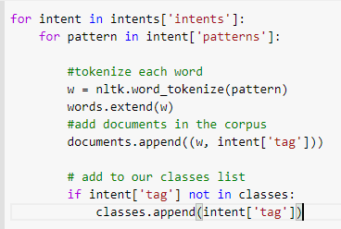
2. Preprocess data
Tokenizing is the most basic and first thing you can do on text data. Tokenizing is the process of breaking the whole text into small parts like words.
Here we iterate through the patterns and tokenize the sentence using nltk.word_tokenize() function and append each word in the words list. We also create a list of classes for our tags.
Notes:
When working with text data, we need to perform various preprocessing on the data before we make a machine learning or a deep learning model. Based on the requirements we need to apply various operations to preprocess the data.

Slide 15
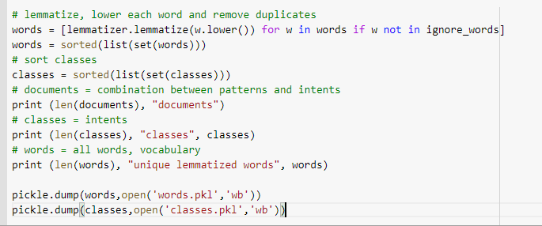
2. Preprocess data
The pickle module implements binary protocols for serializing and de-serializing a Python object structure. “Pickling” is the process whereby a Python object hierarchy is converted into a byte stream.
Notes:
Now we will lemmatize each word and remove duplicate words from the list. Lemmatizing is the process of converting a word into its lemma form and then creating a pickle file to store the Python objects which we will use while predicting.
he pickle module implements binary protocols for serializing and de-serializing a Python object structure. “Pickling” is the process whereby a Python object hierarchy is converted into a byte stream

Slide 16
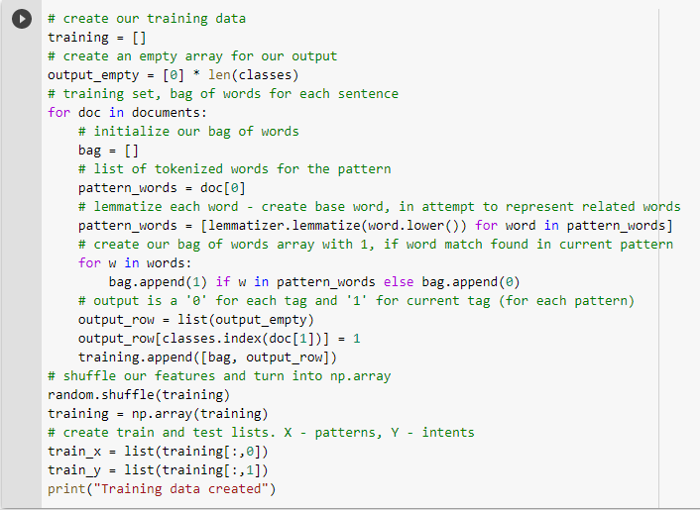
3. Create training and testing data
Notes:
Now, we will create the training data in which we will provide the input and the output. Our input will be the pattern and output will be the class our input pattern belongs to. But the computer doesn’t understand text so we will convert text into numbers.

Slide 17
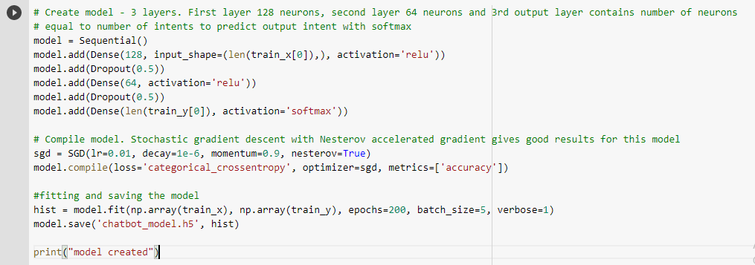
4. Build the model
Notes:
We have our training data ready, now we will build a deep neural network that has 3 layers. We use the Keras sequential API for this. After training the model for 200 epochs, we achieved 100% accuracy on our model. Let us save the model as ‘chatbot_model.h5’.

Slide 18
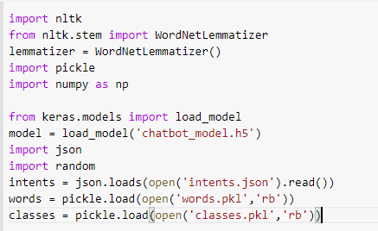
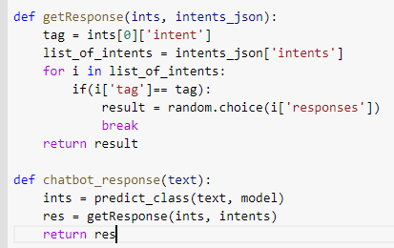
EXECUTING code
5. Predict the response (Graphical User Interface)
Notes:
1-To predict the sentences and get a response from the user to let us create a new file ‘chatapp.py’.
We will load the trained model and then use a graphical user interface that will predict the response from the bot. The model will only tell us the class it belongs to, so we will implement some functions which will identify the class and then retrieve us a random response from the list of responses.
Again we import the necessary packages and load the ‘words.pkl’ and ‘classes.pkl’ pickle files which we have created when we trained our model:
2-After predicting the class, we will get a random response from the list of intents.

Slide 19
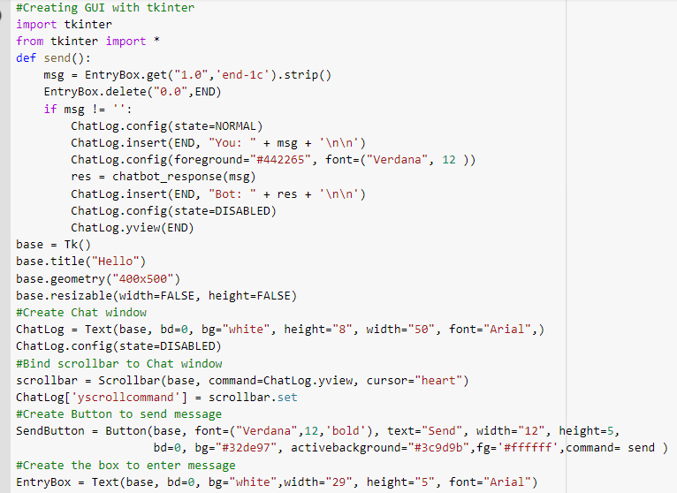
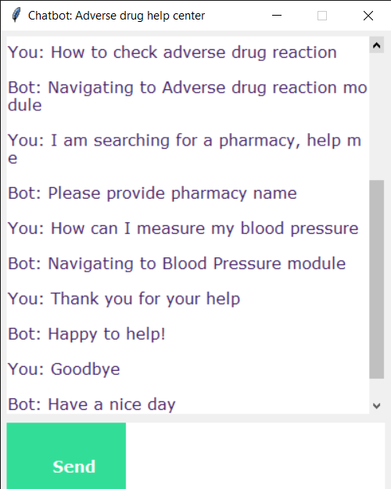
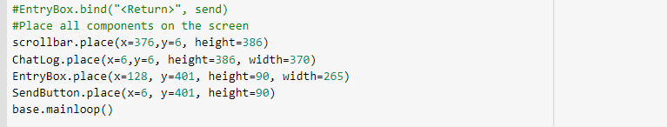
Notes:
Now we will develop a graphical user interface. Let’s use Tkinter library which is shipped with tons of useful libraries for GUI. We will take the input message from the user and then use the helper functions we have created to get the response from the bot and display it on the GUI. Here is the full source code for the GUI.

Slide 20
Demonstration and results
Sorry for removing video, it’s too large
It’s already shown in presrentation
Notes:
This is the video where we will demonstrate how the training and testing codes work

Slide 21
Thank you for your attention!
We hope you don’t have questions ☺

